Slide 1
Social media live project submission
Facebook Campaign
Student Name: Jaismine Kaur

Slide 2
Campaign Problem Statement
Slide 1
To increase traffic for my blog, Lore Cinema, I have created a campaign to increase traffic through the use of meta family products, i.e. facebook, instagram, messener, and audience network.
Blog topic and link: Cinema, Literature, and Art Lore Cinema
Budget provided: ₹1,000
Objective: Increase awareness, i.e., reach and impressions of my blog by running an ad campaign on facebook
TG: 18-65+ years of age, geography: India, interests: cinephiles, literature and art enthusiasts, critics,

Slide 3
Explain the targeting parameters
Slide 2
{Identify the targeting parameters you’d select to amplify your blog Give reasons for the same, even if it is NA.}
Targeting parameters:
Age Range: Targeting an age range of 18-65+ for "Lore Cinema" offers a broad and inclusive approach that can potentially cater to a diverse audience, Cinematic Enthusiasts Across Generations, Cross-Generational Appeal, Diverse Perspectives, Larger Audience Pool
Location: India, as Lore Cinema is a dream to unite all the Indian cinephiles through local literature and community discussions, Worldwide approach may end up diluting the effect in an attempt to be approachable for everyone.
Interests: cinema, literature, art
Any other relevant targeting parameters: NA

Slide 4
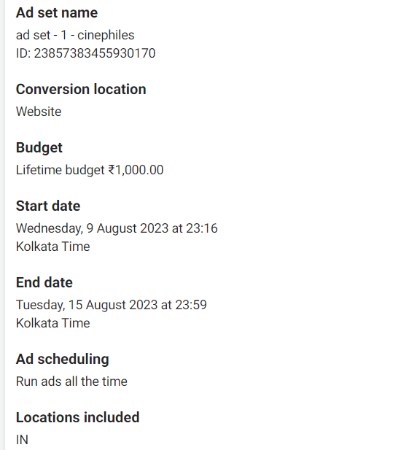
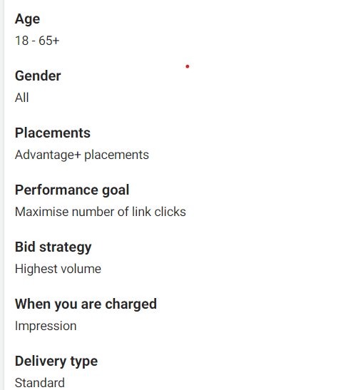
Campaign summary screenshot-1
Slide 3
{Submit screenshots of the campaign order summary for your ad. This should be submitted in 2 slides - screenshot of Ad Set (slide 3/current slide) with Campaign name, Campaign objective, bidding strategy, budget, ad scheduling and the screenshot of actual ad (slide 4/next slide) with image, headline, text and CTA.}

Slide 5
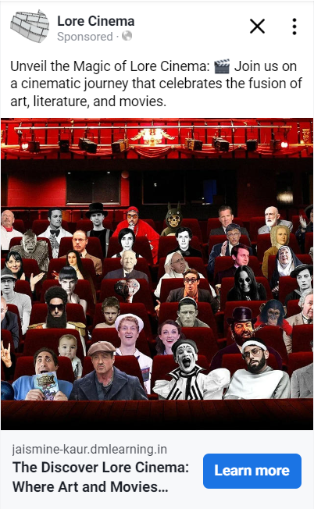
Campaign summary screenshot- 2
Slide 4
{Screenshot of the actual Ad with image, headline, text and CTA.}

Slide 6
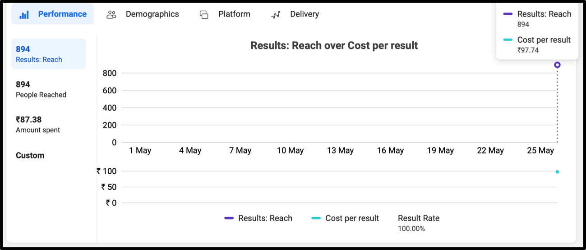
Campaign result screenshot- Performance
Slide 5
{Share the performance screenshot, we have attached a sample screenshot for your reference. Please ensure that the screenshot mentions the Result Rate. Customise the default metrics to enable the Result Rate being shown.}

Slide 7
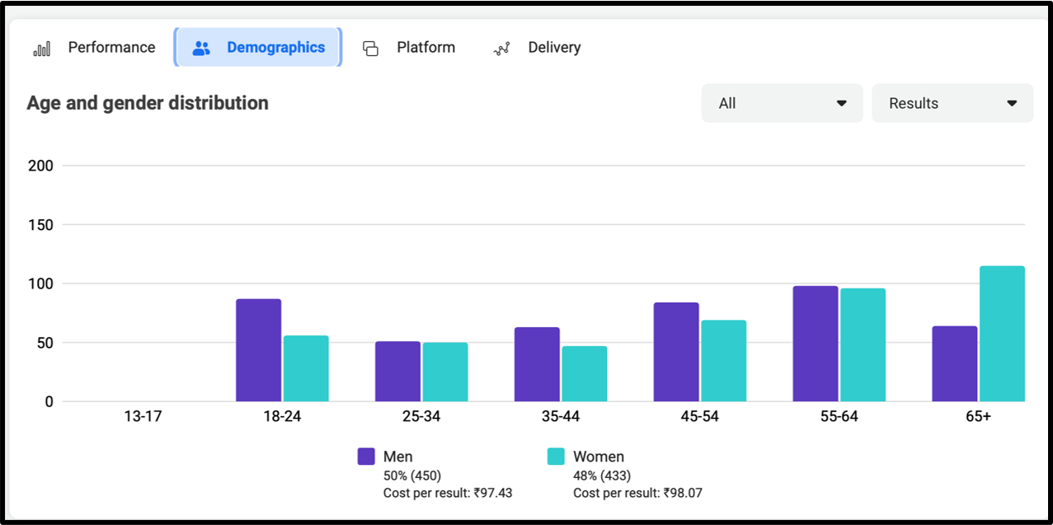
Campaign result screenshot- Demographics
Slide 6
{Share the demographics screenshot,we have attached a sample screenshot for your reference}

Slide 8
Summary
Slide 7
Write a short summary covering following points (Word limit- 150 words):
What KPIs will you use to analyze the ad performance?
Was the campaign a success or not?
Based on the results obtained, suggest some targeting optimizations that you would perform. (atleast 2)
Based on the results obtained, suggest some creative optimizations that you would perform. (atleast 2)

